Slide 1
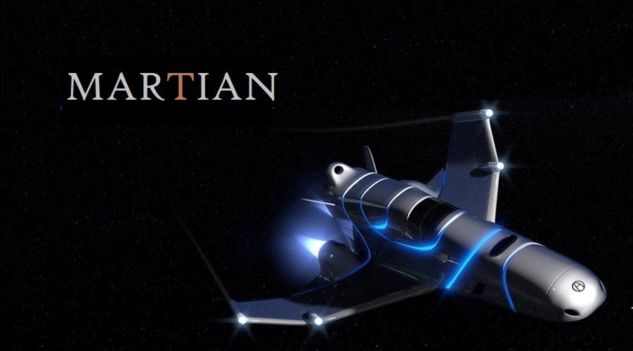

Slide 2
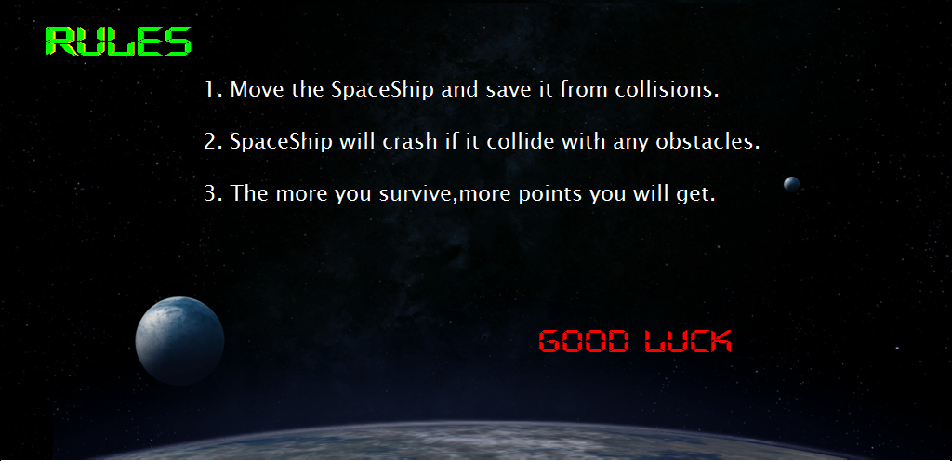

Slide 3
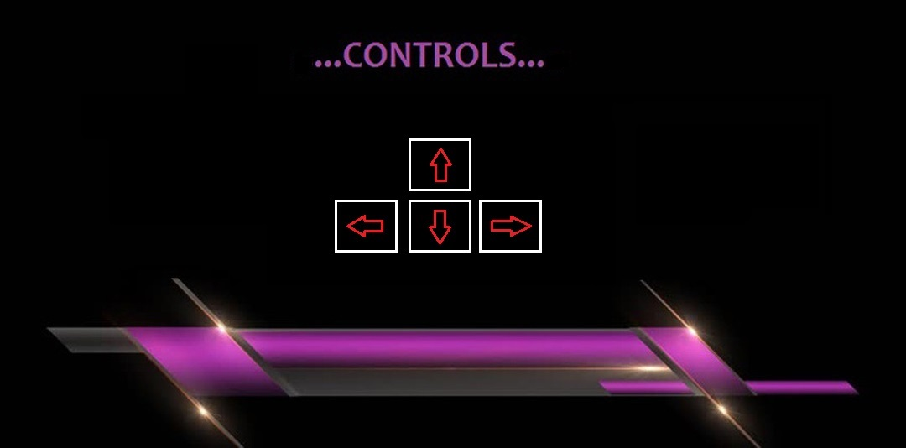

Slide 4
And It Begins with......

Slide 5


Slide 6





* TYPES OF OBSTACLES
Aliens
Comets
Solar flare
Asteroid

Slide 7
When you play the game

Slide 8
Your spaceship is travelling in the space.
Several obstacles are coming to destroy you.
Save yourself and move ahead.

Slide 9
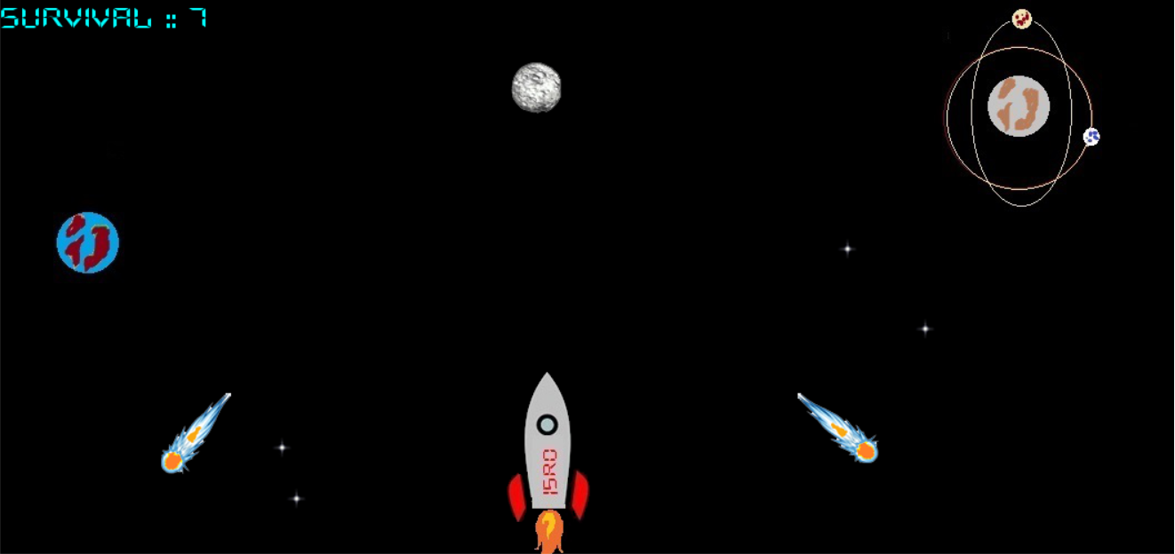

Slide 10
If you loose the control over your keys......
You will loose everything.

Slide 11
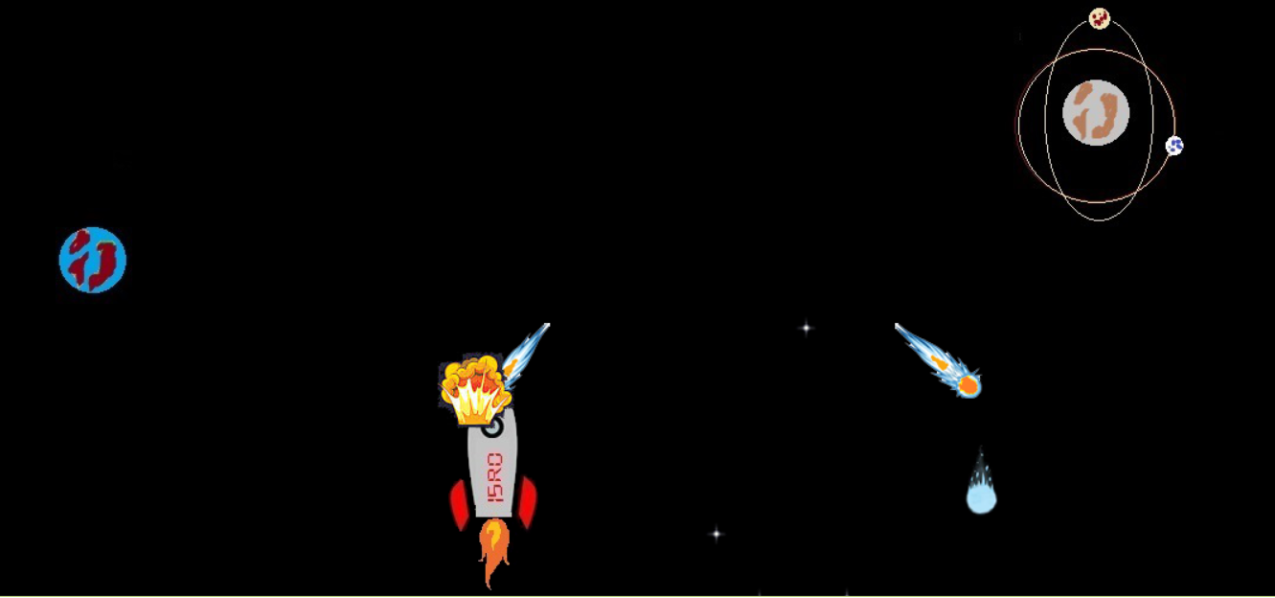

Slide 12
More you survive......
More you explore......

Slide 13
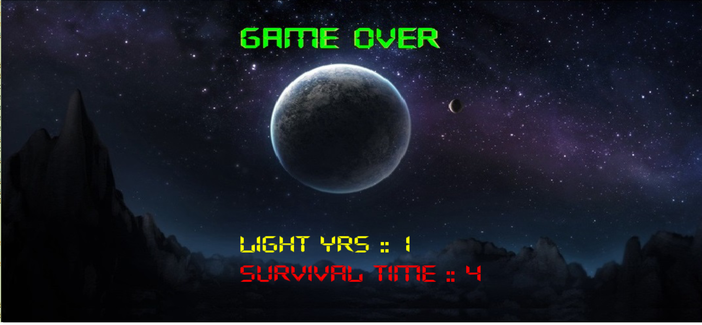

Slide 14
THANK YOU
Aman Jain 11
Adesh Pal 13
Shubham Bauskar 21
Apoorv Natani 22
Himanshu Sahu 26
Prashant Pandey 41

